Slide 1
Transformers, From Zero to Hero
Sourced from JsonBorn7

Slide 2
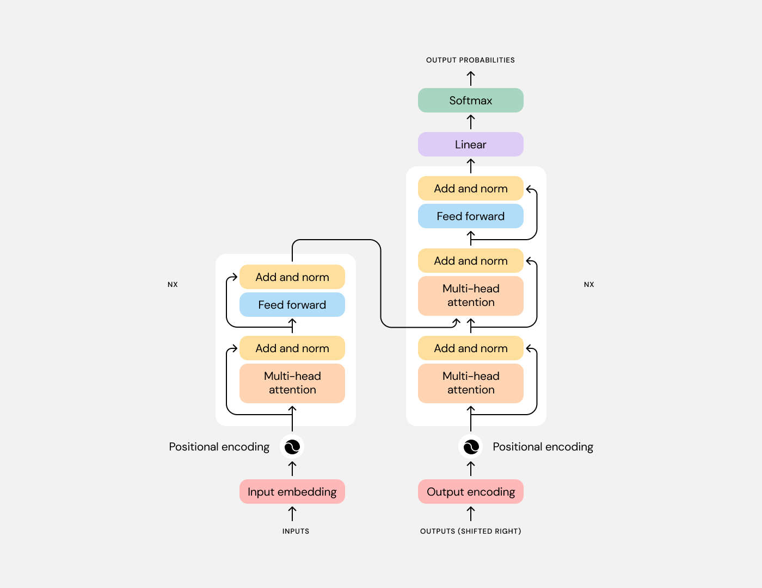

Slide 3
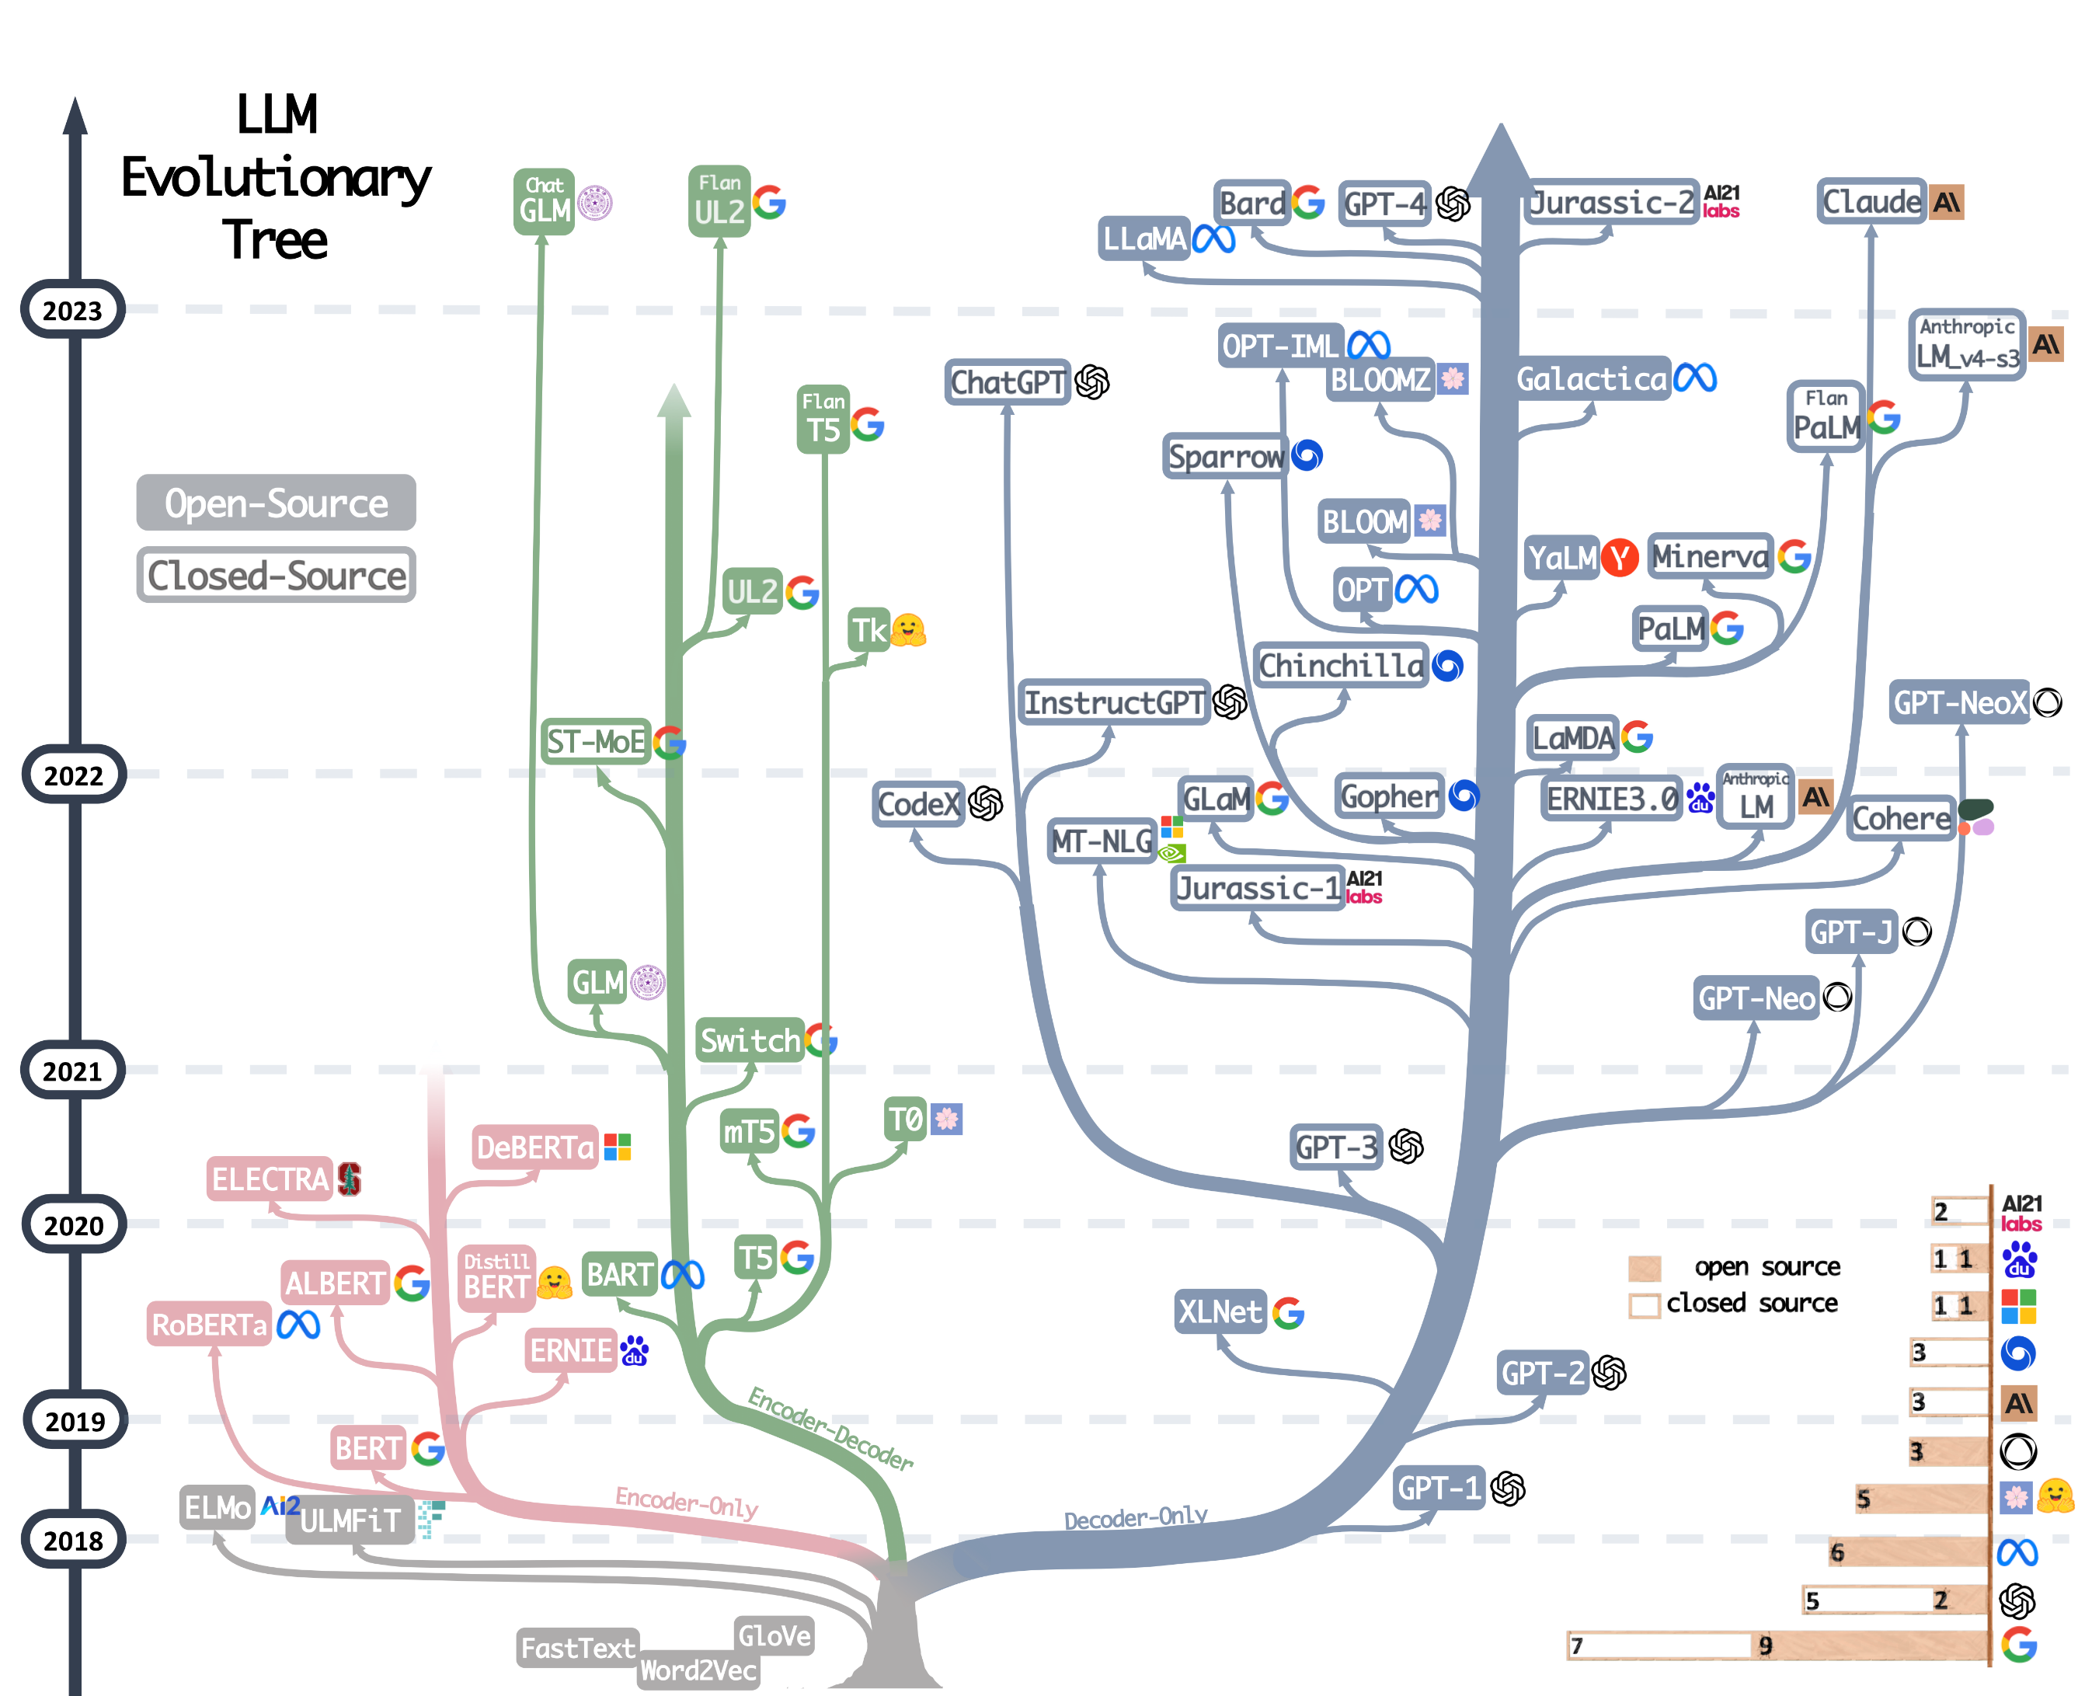

Slide 4
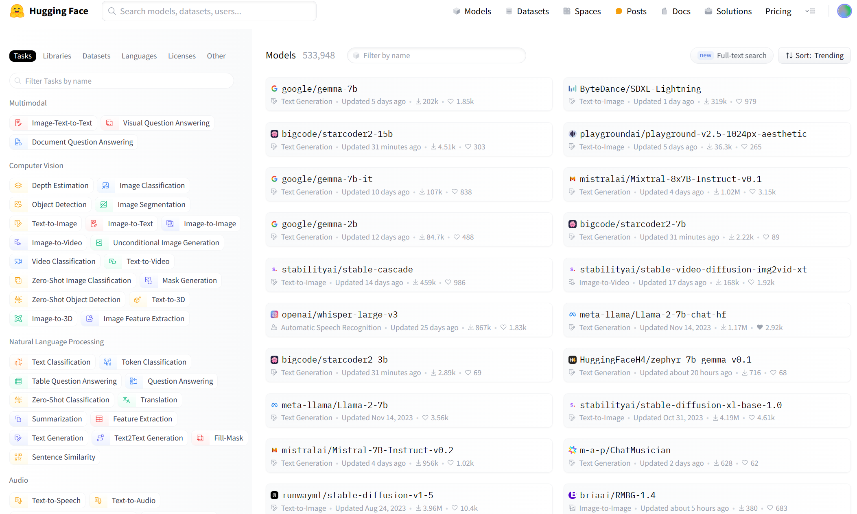
Huggingface

Slide 5
Language model
a
432
2.47, 1.90, 4.95, 1.11, 1.34, -1.16
robot
769
1.21, 4.86, 1.53, 1.33, 8.44, 1.72
must
221
3.35, 3.42, 4.20, 8.24, 1.52, 9.62
obey
Tokenizer
079
Embedding
1.69, 5.39, 6.11, 6.25, 6.73, 8.07
the
775
3.26, 1.14, 1.87, 8.74, 1.74, 1.99
orders
899
1.50, 5.59, 4.34, 9.88, 4.78, 1.67
given
116
1.28, 1.25, 8.72, 7.53, 7.25, 8.31
it
552
552
1.28, 1.25, 8.72, 7.53, 7.25, 8.31

Slide 6
Language model
a
432
2.47, 1.90, 4.95, 1.11, 1.34, -1.16
robot
769
1.21, 4.86, 1.53, 1.33, 8.44, 1.72
must
221
3.35, 3.42, 4.20, 8.24, 1.52, 9.62
obey
Tokenizer
079
Embedding
1.69, 5.39, 6.11, 6.25, 6.73, 8.07
the
775
3.26, 1.14, 1.87, 8.74, 1.74, 1.99
orders
899
1.50, 5.59, 4.34, 9.88, 4.78, 1.67
given
116
1.28, 1.25, 8.72, 7.53, 7.25, 8.31
it
552
1.28, 1.25, 8.72, 7.53, 7.25, 8.31

Slide 7
Language model

Slide 8
Tokenizer & embedding
Tokenizer
Major Algorithms | Typical Model
BPE | GPT, GPT-2, GPT-J, GPT-Neo, RoBERTa, BART, LLaMA, ChatGLM-6B, Baichuan
WordPiece | BERT, DistilBERT，MobileBERT
Unigram | AlBERT, T5, mBART, XLNet

Slide 9
Tokenizer & embedding
One hot encoding
a
432
robot
769
must
221
obey
Tokenizer algorithm
079
the
775
orders
899
given
116
it
552

Slide 10
Tokenizer & embedding
For tokenizers:
The major thinking is how can we choose right way to split the natural language into tokens.
Talk is cheap, let’s CODE(DIAOBAO).

Slide 11
Tokenizer & embedding
432
2.47, 1.90, 4.95, 1.11, 1.34, -1.16
769
1.21, 4.86, 1.53, 1.33, 8.44, 1.72
221
3.35, 3.42, 4.20, 8.24, 1.52, 9.62
079
Embedding
1.69, 5.39, 6.11, 6.25, 6.73, 8.07
775
3.26, 1.14, 1.87, 8.74, 1.74, 1.99
899
1.50, 5.59, 4.34, 9.88, 4.78, 1.67
116
1.28, 1.25, 8.72, 7.53, 7.25, 8.31
1.28, 1.25, 8.72, 7.53, 7.25, 8.31
Notes:
Embedding projector - visualization of high-dimensional data (tensorflow.org)

Slide 12
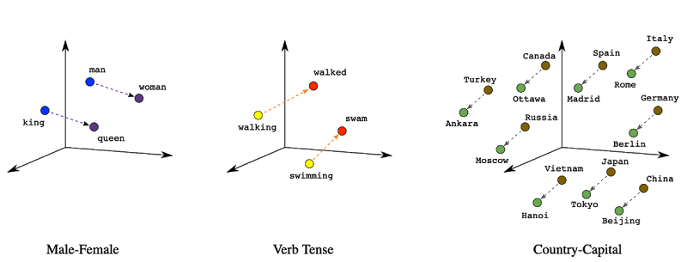
Tokenizer & embedding
man + royal = king
king – man + woman = queen
Notes:
Embedding projector - visualization of high-dimensional data (tensorflow.org)

Slide 13
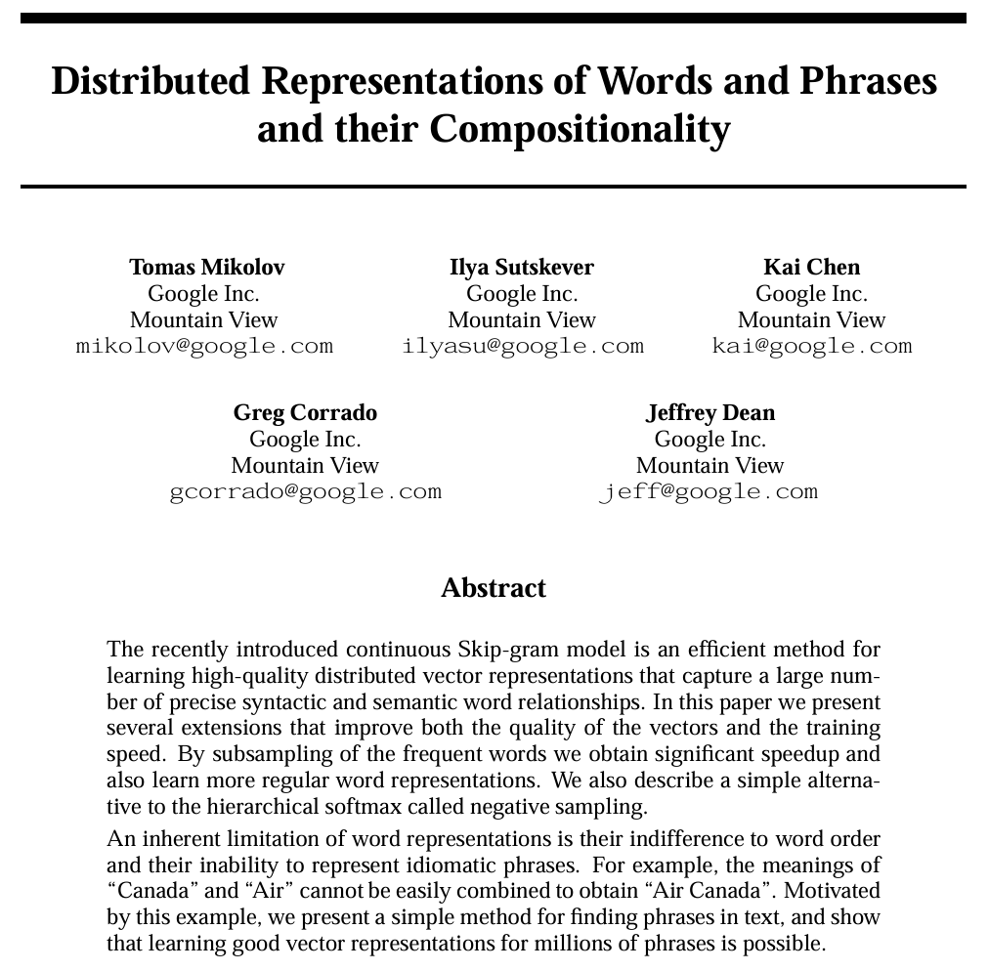
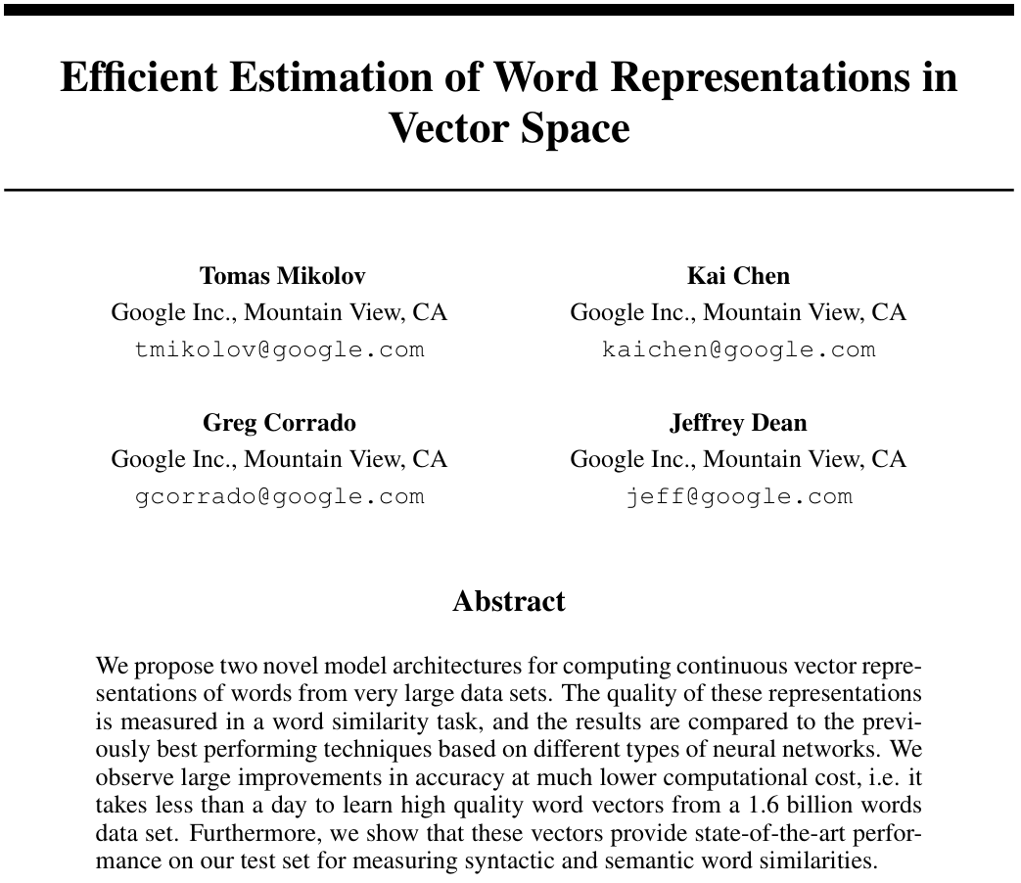
Tokenizer & embedding

Slide 14
Tokenizer & embedding
Output
Softmax
X₁
0
h1
N_{N ×V}
0
N_{V×N}
0
X₂
0
h2
Matrix W’
Matrix W
X₃
0
h3
0
Vector of word i
…
…
…
X_{i}
1
V
…
N
1
X_{i+1}
0
0
…
…
…
…
X_{V-1}
0
h_{N-1}
0
Embedding matrix
Context matrix
0
X_{V}
0
h_{N}

Slide 15
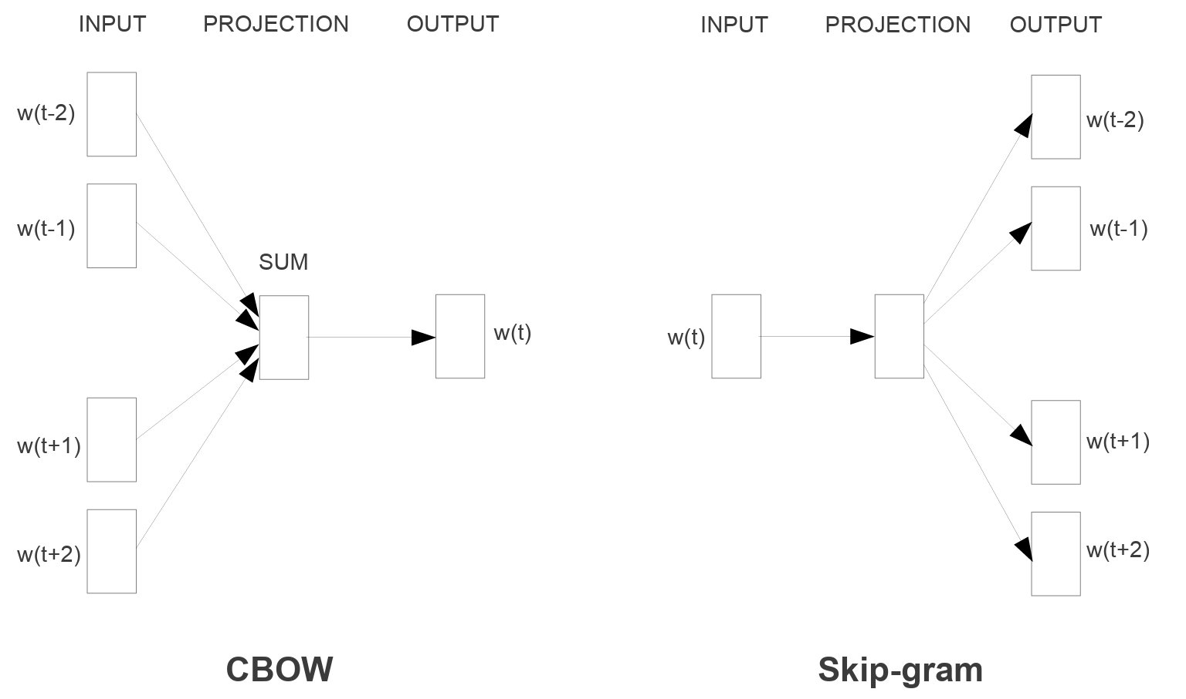
Tokenizer & embedding

Slide 16
Tokenizer & embedding

Slide 17
Tokenizer & embedding
window=2
window=2
射
雕
英
雄
传
[射, 雕, 雄, 传]
[英]
交叉熵损失
射 [1, 0, 0, 0, 0]
Embedding
0.1
0.1
0.6
0.1
0.1
0
0
1
0
0
Embedding Matrix
Context Matrix
雕 [0, 1, 0, 0, 0]
Ave
雄 [0, 0, 0, 1, 0]
传 [0, 0, 0, 0, 1]
Ave
Target
Cross Entropy

Slide 18
Tokenizer & embedding
For embedding:
The major thinking is how can each token vectors represent their meanings in higher dimension.
Talk is cheap, let’s CODE(DIAOBAO).

Slide 19
soft max
linear
+
feed forward
layer norm
+
Masked multi-head attention
layer norm
token embedding
position embedding

Slide 20
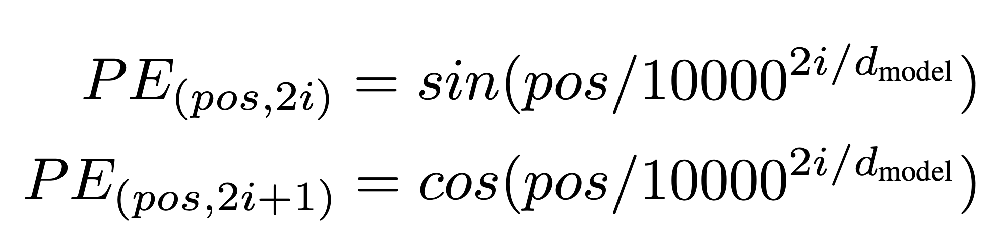
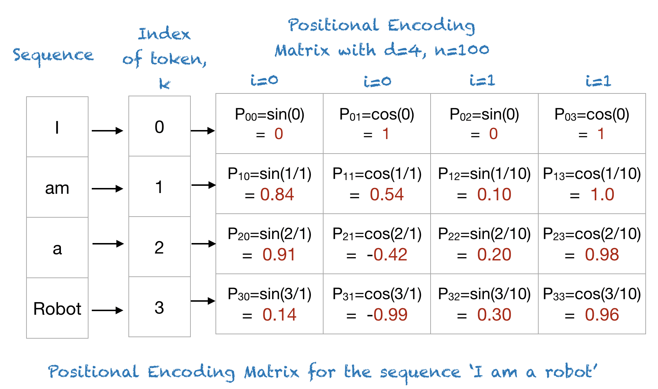
Transformers-position embedding

Slide 21
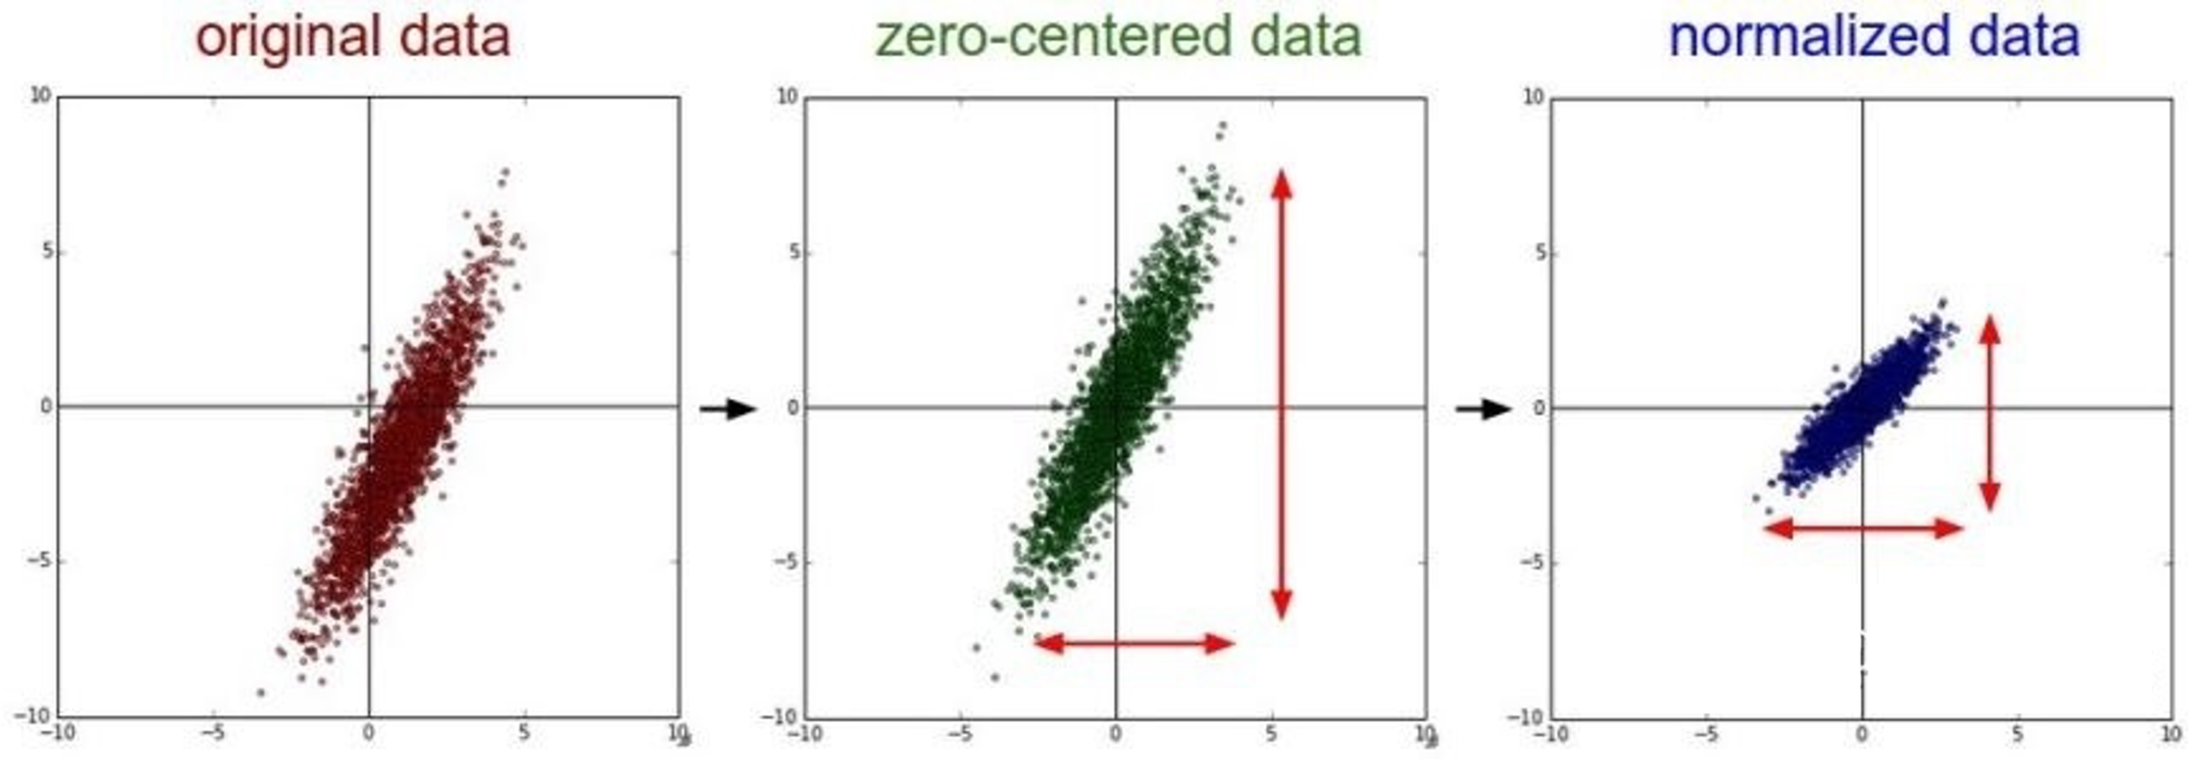
Transformers-layer norm

Slide 22
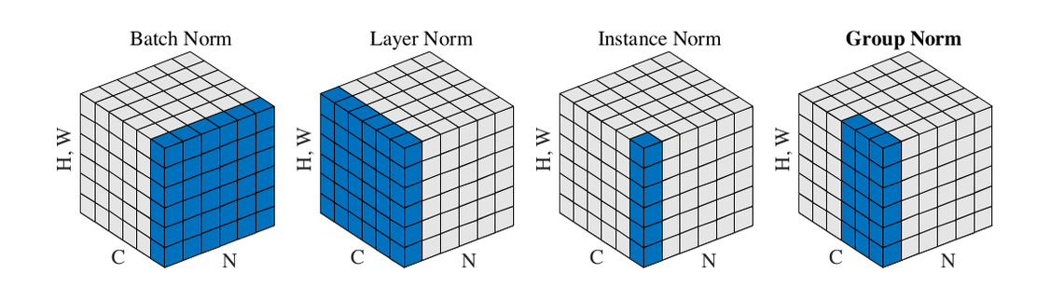
Transformers-layer norm

Slide 23
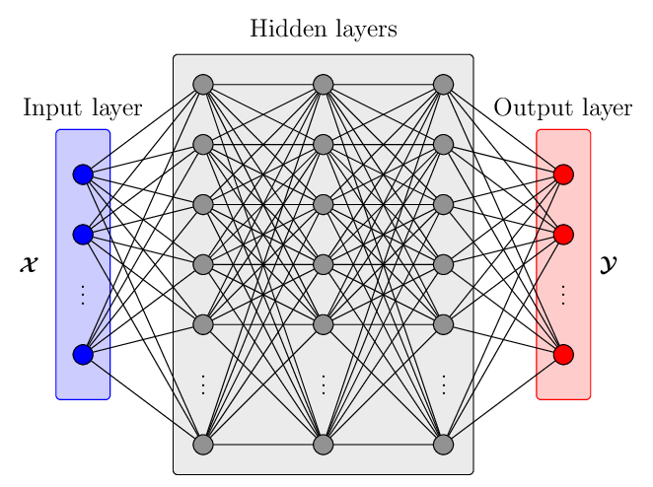
Transformers-FFN

Slide 24
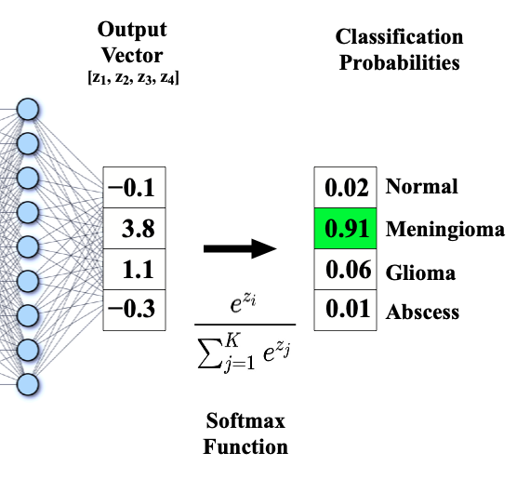
Transformers-softmax

Slide 25
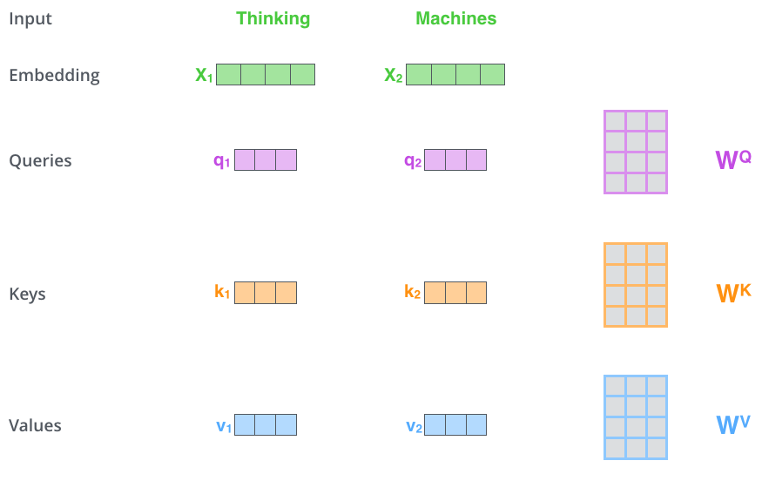
Transformers-attention

Slide 26
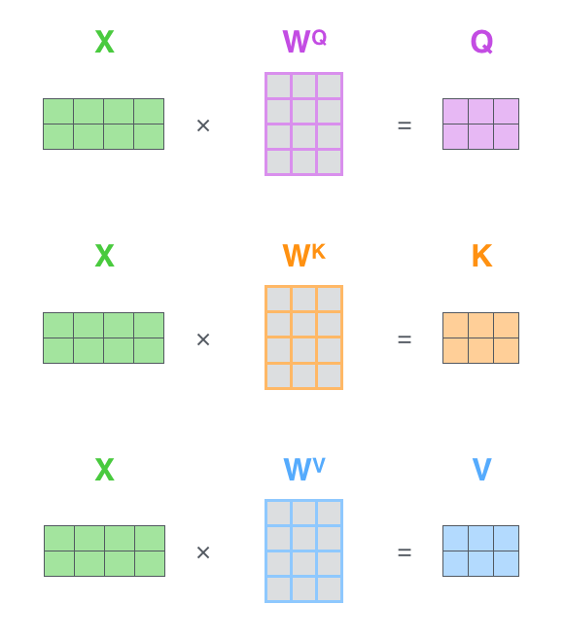
Transformers-attention

Slide 27
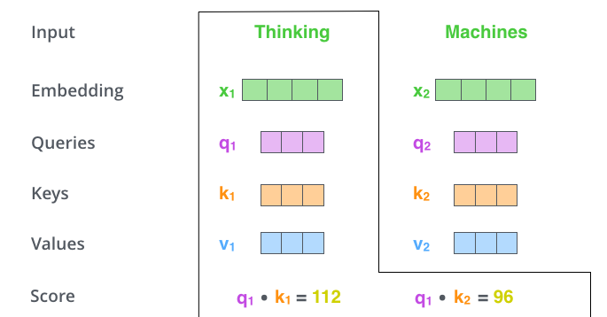
Transformers-attention

Slide 28
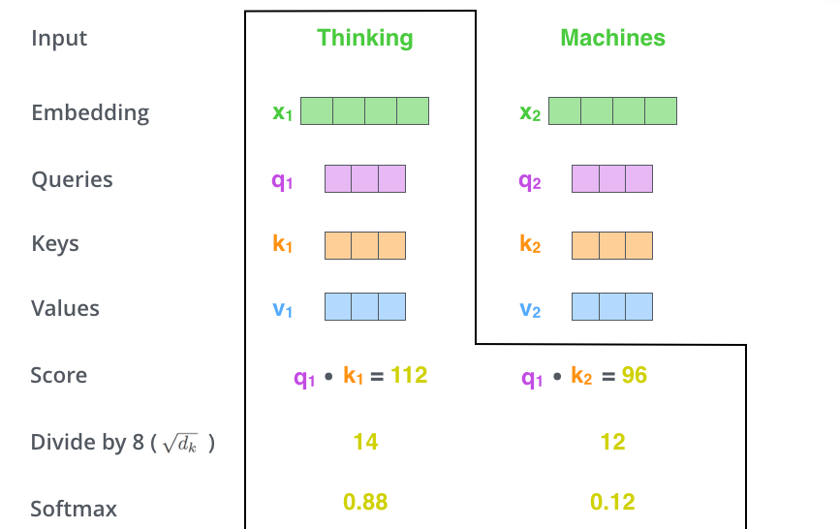
Transformers-attention

Slide 29
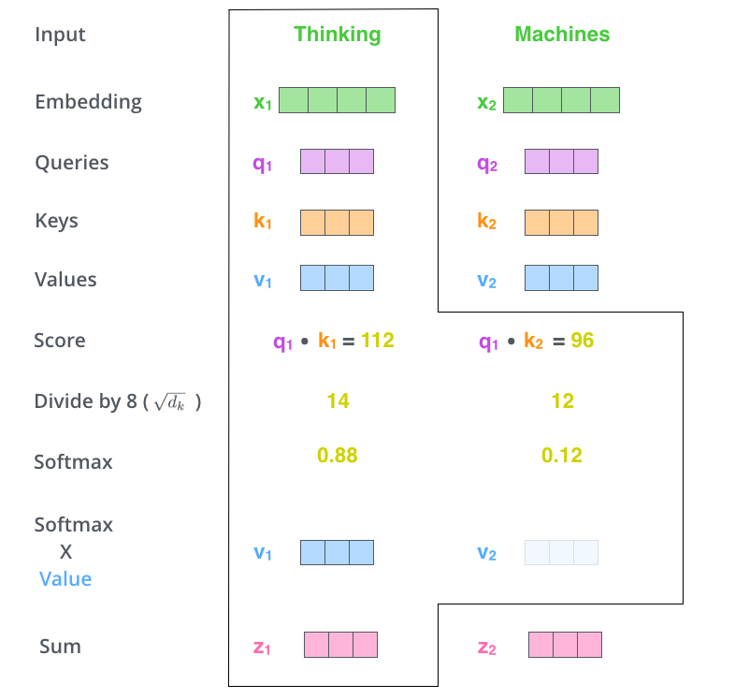
Transformers-attention

Slide 30
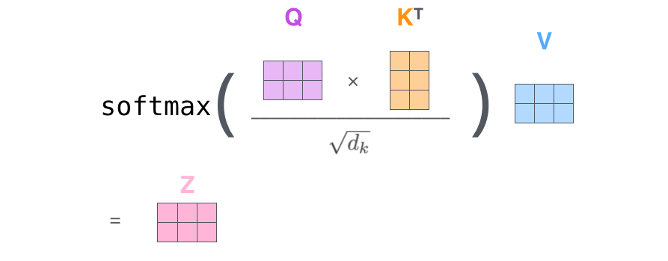
Transformers-attention

Slide 31
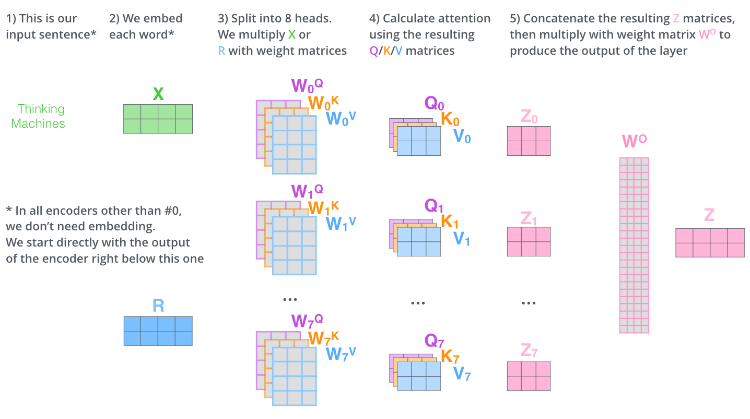
Transformers-attention

Slide 32
soft max
linear
+
feed forward
layer norm
+
Masked multi-head attention
layer norm
token embedding
position embedding

